Slide 1
2020 Mississippi Judicial Elections
Presented By:
Hawley Robertson
Assistant Secretary of State
Elections Division

Slide 2
Qualifying to Run for Judicial Office
Candidates must file a “Statement of Intent” to be a candidate for judicial office not later than 5:00 PM on the March 2, 2020. (Miss. Code Ann. §23-15-977)
Candidates must also file an “Affidavit of Judicial Candidate” affirming to abide by all laws, canons and regulation applicable to elections for judicial office. (Miss. Code Ann. §23-15-977.1)
The “Qualifying Statement of Intent,” “Affidavit of Judicial Candidate,” and fee should be filed with the State Board of Election Commissioners.

Slide 3
State Board of Election Commissioners
Members include the Governor, Secretary of State, and Attorney General.
Rule on candidate’s qualifications.
Hear any contest or complaints regarding candidate qualifications.
Approve General/Special Election Ballot.

Slide 4
Judicial Elections Nonpartisan
Judicial offices are deemed nonpartisan (Miss. Code Ann. 23-15-976)
Candidates cannot campaign or qualify for office based on party affiliation.
A judge or judicial candidate shall refrain from inappropriate political activity. (Miss. Code of Judicial Conduct Canon 5)

Slide 5
Campaign Finance Filings
Candidates, or committees which support or oppose candidates, for Supreme Court, Court of Appeals, Chancery and Circuit Court file with the Secretary of State.
Candidates, or committees which support or oppose candidates, for county court judge file with the county circuit clerk’s office.

Slide 6
Judicial Campaign Finance and Disclosure
Judicial campaigns have additional requirements under campaign finance and disclosure laws.
Canon 5 of the Judicial Code of Conduct supplements the statutory requirements.

Slide 7
Campaign Finance Limitations
Supreme Court and Court of Appeals
It is unlawful for an individual or a nonpartisan political action committee to donate funds or property in excess of $5000.00.
Circuit, Chancery and County Court
It is unlawful for an individual or a nonpartisan political action committee to donate funds or property in excess of $2500.00.
Corporate Campaign Contribution Limit
$1000.00 per year per candidate.
Reference: Miss. Code Ann. §23-15-1021

Slide 8
Campaign Committee
A judicial candidate shall not personally solicit or accept campaign contributions or personally solicit publicly stated support. However, a judicial candidate may establish committees to conduct campaigns for the candidate through media advertisements, brochures, mailings, candidate forums and other means not prohibited by law.
Reference:
Canon 5C(2)

Slide 9
Campaign Committee
A Campaign Committee:
May solicit and accept reasonable campaign contributions, manage the expenditure of funds for the campaign and obtain public statements of support for the candidacy.
May solicit and accept reasonable campaign contributions and public support from lawyers.
Shall NOT solicit or accept contributions and public support earlier than 60 days before the qualifying deadline or later than 120 days after the last election in which the candidate participates.
Reference:
Canon 5C(2)

Slide 10
Campaign Committee
Creating a Campaign Committee:
Each committee must file a Statement of Organization no later than 48 hours after receipt of contributions aggregating in excess of Two Hundred Dollars ($200.00), or having made expenditures aggregating in excess of Two Hundred Dollars ($200.00).
Upon creating a committee, the committee must file the appropriate campaign finance reports until a Termination Report is filed.
Reference:
Miss. Code Ann. §§23-15-803, 23-15-805

Slide 11
Campaign Finance Filing
Each candidate or political committee shall file reports of contributions and disbursements in accordance with the provisions of Miss. Code Ann. §23-15-807.
All candidates and committees required to report may terminate its obligation to report only upon submitting a Termination Report that it will no longer receive any contributions, make any disbursements and such candidate or committee has no outstanding debts or obligations.
Reference:
Miss. Code Ann. §23-15-807

Slide 12
Campaign Finance Filing
Each candidate and political committee must disclose:
Total amount of all contributions and total amount of all expenditures.
Identity of each person, political committee or entity who makes a contribution in the calendar year in excess of $200.00.
Identify of each person or entity who receives an expenditure in the calendar year in excess of $200.00.
Total amount of cash on hand.
Office in which the report must be filed must be in actual receipt of the report by 5:00 p.m. on the reporting deadline.
Reference: Miss. Code Ann.
§23-15-807

Slide 13
Campaign Finance Forms www.sos.ms.gov
Judicial Election Candidate Form
Judicial Election Candidate’s Committee Form
Judicial Election Political Committee Form
Judicial Loan Form
Statement of Organization
Itemized Receipts
Itemized Disbursements
48 Hour Report of Reportable Contributions

Slide 14
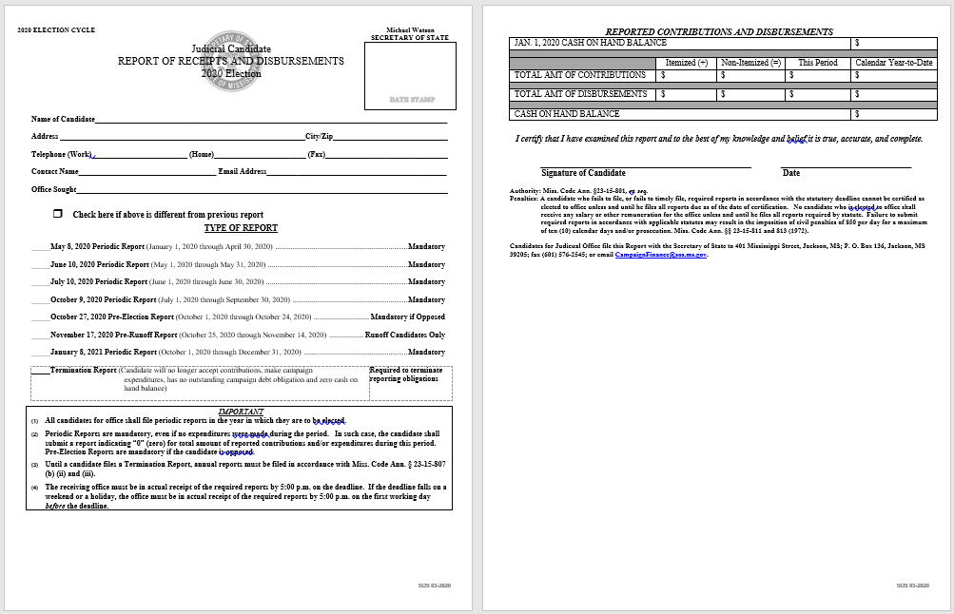

Slide 15
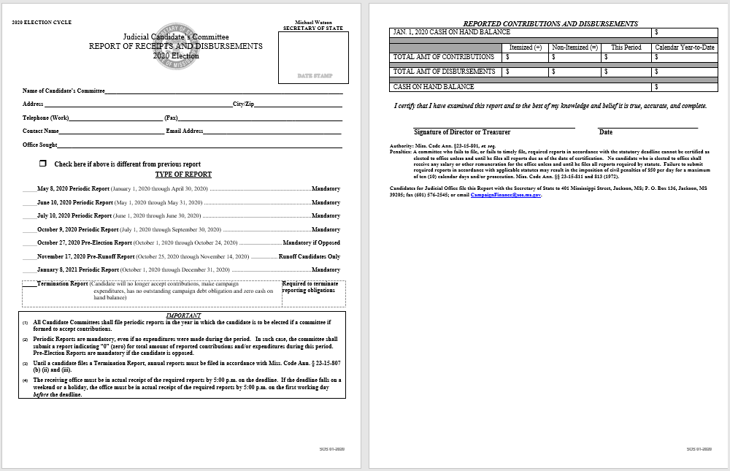

Slide 16
Disclosure of Judicial Loan
Judicial candidates shall disclose the identity of any individual or entity from which the candidate’s committee receives a loan or other extension of credit for use in his campaign.
Cosigners for a loan or extension of credit must also be identified.
Candidates must disclose how the loan will be used, repaid and method of repayment.
Loan documents must be disclosed.
Reference:
Miss. Code Ann. §23-15-1023

Slide 18
Disclosure of Campaign Finance
Substantially Compliant:
All fields of information must be completed on the Report of Receipts and Disbursements.
Itemized Receipts:
Identification of any individual by full name, mailing address, date, amount of receipt for the period and one additional field of information, such as the name of an employer or occupation of the individual.
Identification of any other source, such as family, firm, corporation, partnership, association, political committee or other legal entity by full name, mailing address, date, amount of each receipt for the period.
Itemized Disbursement:
Identification by full name, mailing address, date and amount of each disbursement to each person or organization which receives expenditures during the reporting period.

Slide 19
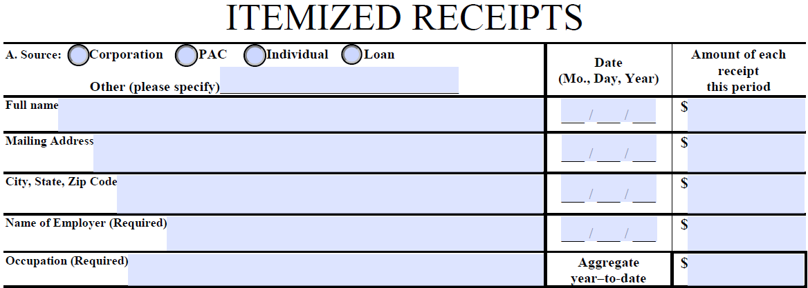
Itemized Receipt Form

Slide 20
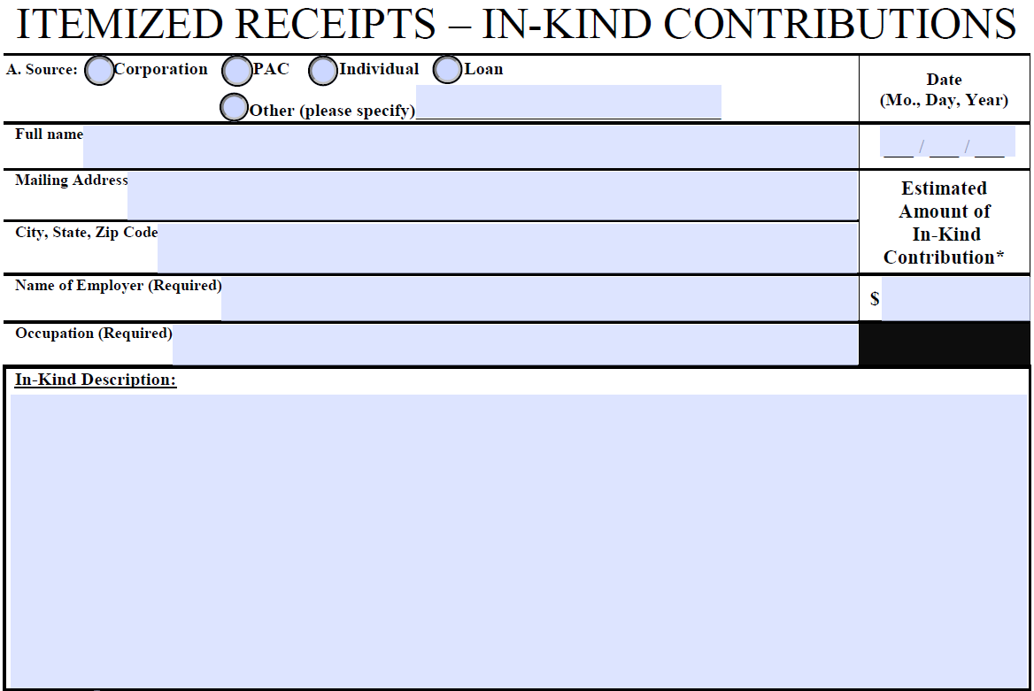
Itemized Receipt Form

Slide 21
Itemized Disbursement Form

Slide 22
48-Hour Reports
If a candidate’s committee receives a contribution of more than $200 after the tenth day, but more than 48 hours before 12:01 a.m. on the day of the election, the candidate or committee must disclose the contribution by filing a 48-Hour Report with the appropriate office within 48 hours of the contribution.

Slide 24
Mississippi Ethics Commission
Civil Penalty:
The Mississippi Ethics Commission is now responsible for assessing civil penalties for failure to file, or filing late, campaign finance reports which are required to be filed with the Secretary of State.
Nine (9) day grace period, and fines begin on the tenth (10th) day.
$50.00 per day for up to ten (10) days.

Slide 25
Campaign Finance Public Search

Slide 26
Online Filing System

Slide 28
Begin Filing Session

Slide 29
Generate Judicial Reports

Slide 30
Additional Filings

Slide 31
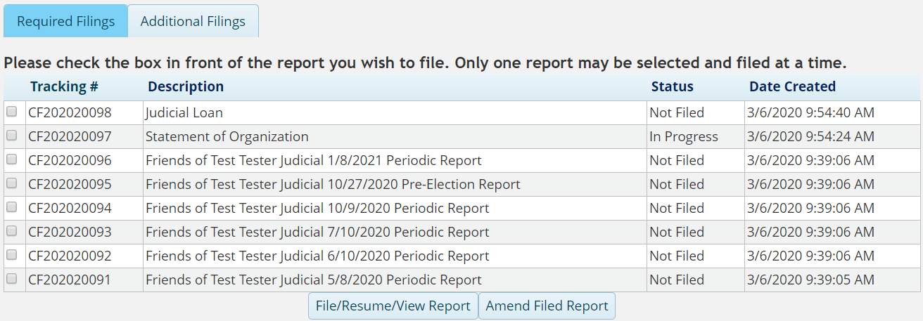
Example of Assigned Filings

Slide 32
Contributions & Disbursements

Slide 33
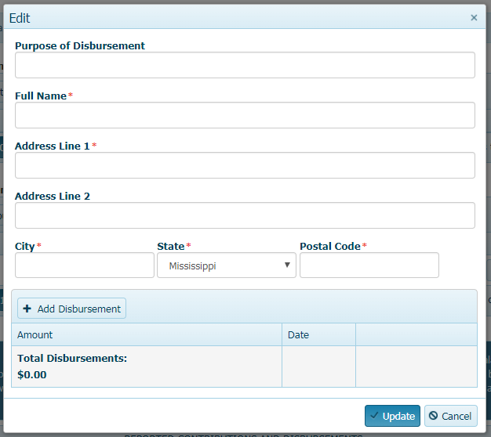
Itemized Contributions &Disbursements

Slide 34
Excel Templates

Slide 35
Total Contributions & Disbursements

Slide 36
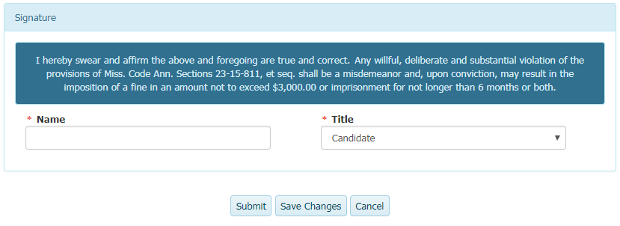
In-Kind Contributions & Signature

Slide 37
Distribution of Campaign Materials
Any materials distributed by a judicial candidate, his committee or any person or entity shall state it is distributed by the candidate or it is being distributed with the candidate’s approval.
Materials shall conspicuously identify who has prepared the material and who is distributing the material.
Reference:
Miss. Code Ann. §23-15-1025

Slide 38
Distribution of Campaign Materials
If the candidate has not approved the material, the material shall so state.
Further, the identity of the organization(s) or committee(s) paying for or causing the distribution of the campaign materials shall state the names of all officers of the organization(s) or committee(s).
Reference:
Miss. Code Ann. §23-15-1025

Slide 39
Publication of Campaign Materials through an Electronic Platform
“Publish” means the act or instance of making campaign material available to the public or to a list of subscribers, by mail, telephone, electronic communications platforms, Internet, software applications, printed materials or any other means of distribution.
Publication through an electronic platform is deemed compliant if the home page discloses the statutorily required information and each electronic publication provides a link to that home page.
Reference: § 23-15-897, Miss. Code Ann.

Slide 40
Available on Website
2020 Candidate Qualifying List
2020 Candidate Qualifying Guide
Candidate Qualifications and Forms
2020 Campaign Finance Guide
2020 Campaign Finance Reporting Schedule
2020 Campaign Finance Forms
2020 Elections Calendar

Slide 41
Contact Information Mississippi Secretary of State’s Office Elections Division
Physical Address:
401 Mississippi Street
Jackson, MS 39201
Elections Hotline:
(601)576-2550 or
(800)829-6786
Website: www.sos.ms.gov
Mailing Address:
P.O. Box 136
Jackson, MS 39205
Fax: (601)576-2545
Email: CampaignFinance@sos.ms.gov

